Slide 1
React JS
Not another JS framework

Slide 2
Agenda
What is React JS
Virtual DOM
Data Flow
Components
States
JSX

Slide 3

ReactJS is a JavaScript library for building User Interfaces
It represents only the V (view) part of MV* (model – view – wildcard) frameworks.
https://reactjs.org

Slide 4
Virtual DOM
Virtual DOM is abstraction lightweight “copy” of the existing DOM
React uses Virtual DOM for all UI changes
Virtual DOM vs (Real) DOM
Virtual DOM has better performance than DOM for UI manipulations
Virtual DOM uses observables instead of dirty check to detect the changes
Batch update which finds the minimum steps to update the DOM
Virtual DOM render only the parts which has been changed, or all of them on page load.

Slide 5
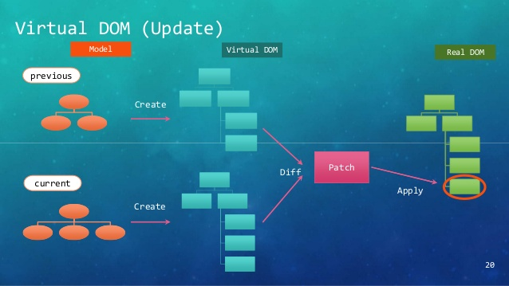
How Virtual DOM works

Slide 6
Data flow
In React JS, data flows in one direction, from Parent to Child. This helps components to be simple and predictable.
Consider React components as simple functions that receive props and state and return HTML.
When child components receive props from their parents, they either apply modifications (render) or pass it to another child that may use it.

Slide 7
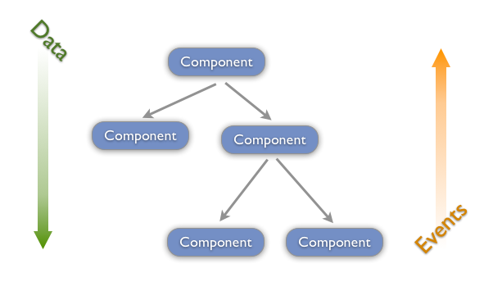
Data flow vs Events flow diagram

Slide 8
Components
Components let you split the UI into independent, reusable pieces, and think about each piece in isolation.
Conceptually, components are like JavaScript functions. They accept arbitrary inputs (called “props”) and return React elements describing what should appear on the screen.
function Welcome(props)
{
return<h1>,{props.name}</h1>;
}

Slide 9
class Welcome extends React.Component
{
render()
{
return <h1>Hello, {this.props.name}</h1>;
}
}

Slide 10
JSX
JSX is a preprocessor step that adds XML syntax to JavaScript. You can definitely use React without JSX but JSX makes React a lot more elegant. Just like XML,JSX tags have a tag name, attributes, and children. If an attribute value is enclosed in quotes, the value is a string.

Slide 11
//Wihtout JSX
<div className="red">Children Text</div>;
<MyCounter count={3 + 5} />;
// Here, we set the "scores" attribute below to a JavaScript object.
var gameScores = { player1: 2, player2: 5 };
<DashboardUnit data-index="2">
<h1>Scores</h1>
<Scoreboard className="results" scores={gameScores} />
</DashboardUnit>;

Slide 12
//With JSX
React.createElement("div", { className: "red" }, "Children Text");
React.createElement(MyCounter, { count: 3 + 5 });
React.createElement( DashboardUnit,
{ "data-index": "2" },
React.createElement("h1", null, "Scores"), React.createElement(Scoreboard, { className:"results", scores:gameScores })
);
Why className ?

Slide 13
Demo ToDo
https://codepen.io/mfunkie/pen/BnzKx

